Slide 1

SCHOOL OF COMPUTING
DEPARTMENT OF COMPUTER SCIENCE & ENGINEERING
WINTER SEMESTER 2024-2025
10214CS701- MAJOR PROJECT INHOUSE
“PREVENTION OF CARDIOMETABOLIC RISK USING SMART GAS ANALYZER”
SEMESTER END PROJECT VIVA VOCE EXAMINATIONS
RESENTED BY
P.REKHA SHANMUKHI(VTU19523)(21UECS0454)
S.GOPINADH(VTU19522)(21UECS0560)
P.NEERAJA(VTU19613)(21UECS0483)
SUPERVISED BY
Dr. N.Gomathi/Professor
DEPARTMENT OF COMPUTER SCIENCE & ENGINEERING

Slide 2

CONTENT
Introduction
Objective of the Project
Literature Review / Existing System
Literature Review Summary
Proposed System
Methodology / Architecture
Algorithm with Description
Implementation
Testing & Validation
Results & Analysis
Sustainable Development Goals(SDG)
Demonstration/Prototype Showcase
Challenges Encountered & Solutions
Advantages
Limitations & Future Scope
Conclusion
YouTube Demonstration Video URL & GitHub Link
Placement offer letter /Internship offer letter/Completion certificate
References
DEPARTMENT OF COMPUTER SCIENCE & ENGINEERING

Slide 3
Introduction
Brief intro to the project topic
Cardiometabolic diseases—including diabetes, hypertension, obesity, and cardiovascular conditions—are among the leading causes of death and disability worldwide. These conditions often develop silently and share common risk factors such as oxidative stress, inflammation, and impaired metabolism. Breath analysis is emerging as a non-invasive method to detect disease-related biomarkers through volatile gases. This project aims to design a smart gas-detection system using sensors to monitor key gases (CO, CO₂, alcohols, H₂S) in exhaled breath, providing real-time health alerts via an LED display.
Motivation behind choosing the topic
Many people remain unaware of their cardiometabolic risks until symptoms become severe, largely due to the lack of accessible, early screening tools. Traditional methods are invasive, time-consuming, and expensive. The idea of using breath-based sensing inspired us to explore a more user-friendly, low-cost, and non-invasive method for early health risk detection. We chose this topic to develop a practical solution that could empower individuals, especially in underserved areas, to monitor their health conveniently and take preventive measures.
Problem Statement
There is a lack of affordable, non-invasive, and easy-to-use tools for early detection of cardiometabolic risk in everyday settings. Existing diagnostic techniques are mostly clinical, invasive, and not suitable for frequent self-monitoring. This project addresses this gap by developing a compact device that detects abnormal concentrations of specific gases in breath—indicators of metabolic dysfunction—and provides instant visual alerts, enabling proactive health management and early intervention.
DEPARTMENT OF COMPUTER SCIENCE & ENGINEERING

Slide 4
Objective of the Project
The main objective of this project is to develop a smart, non-invasive gas detection system that can identify early indicators of cardiometabolic diseases by analyzing exhaled breath. The system integrates gas sensors capable of detecting carbon monoxide (CO), carbon dioxide (CO₂), hydrogen sulfide (H₂S), and alcohols (ethanol, isopropanol)—gases that are known to reflect metabolic health, oxidative stress, and liver function. These sensors are connected to a microcontroller that processes the data and displays alerts on an LED screen when gas concentrations exceed safe thresholds.
By offering real-time analysis and alerts, the device aims to support early detection and monitoring of conditions such as diabetes, obesity, hypertension, and cardiovascular diseases. The project emphasizes accessibility by creating a low-cost, portable tool that can be used at home or in community health settings. Ultimately, the goal is to empower individuals with timely health information, encouraging preventive action and reducing the burden on clinical healthcare systems.
DEPARTMENT OF COMPUTER SCIENCE & ENGINEERING

Slide 5
Literature Review / Existing System
Reference# (Year) | Problem Domain | Input Data | Feature Extraction | Classification | Result
[1] Rodriguez et al. | Real-time health analytics with AI & cloud computing for cardiometabolic risk tracking | Exhaled breath data | AI-driven analytics | Continuous monitoring system | Demonstrates feasibility for early detection and continuous monitoring via cloud-AI integration
[2] Germanese et al. | Low-cost breath analysis for self-monitoring | Exhaled breath | Biomarker detection | Breath analysis system | Shows feasibility of using breath biomarkers to monitor cardiometabolic risks
[3] Musleh et al. | Predicting cardiometabolic risk in students | Health records of students | ML algorithm training | Various ML classifiers | Demonstrates early intervention potential with ML
[4] Patel et al. | Wearable tech in health tracking | Sensor data from wearables | Biosensing capabilities | Wearable-integrated gas sensors | Real-time capture of metabolic data using gas sensors in wearables
[5] Singh & Bose | DL in healthcare risk prediction | Breath data | Neural networks (DL) | Deep learning models | Neural networks successfully detect early signs of cardiometabolic issues
DEPARTMENT OF COMPUTER SCIENCE & ENGINEERING

Slide 6

Reference# (Year) | Problem Domain | Input Data | Feature Extraction | Classification | Result
[6] Williams & Brown | AI-driven predictive analytics for chronic disease prevention | Breath data | AI-based predictive features | Predictive analytics | Supports effectiveness of AI in interpreting gas analyzer outputs
[7] Nakamura et al. | AI-assisted breath analysis for respiratory diseases | Exhaled breath | AI-based models | Breath diagnostics | Demonstrates viability of breath diagnostics for metabolic disorder detection
[8] Wang & Zhou | Big data analytics for CVD prediction | Sensor data | Big data methods | Predictive models | Highlights power of large- scale sensor data for early detection
[9] Garcia & Thompson | Smart devices for chronic disease prevention | Continuous sensor data | Integrated sensors | Smart health devices | Reinforces gas analyzer relevance in long-term health management
[10] Martinelli et al. | Modeling using sensor measurements | Sensor data from breath | Modeling framework | Risk assessment framework | Validates clinical relevance of breath-based risk data

Slide 7
Reference# (Year) | Problem Domain | Input Data | Feature Extraction | Classification | Result
[11] Sharma & Verma | Edge computing in real- time healthcare | Sensor data | Edge computing framework | Real-time processing | Supports low-latency deployment of smart gas analyzers
[12] Gupta & Roy | IoT-enabled healthcare systems | IoT-based sensor data | IoT interoperability | Health system integration | Highlights importance of integrating analyzers with health infra
[13] Kumar et al. | Role of sensors in non- invasive monitoring | Real-time sensor data | Sensor signal processing | Continuous monitoring | Reinforces gas sensor effectiveness in early cardiometabolic detection
[14] Chen & Wu | Exhaled breath for disease detection | VOCs in breath | VOC profiling | Disease detection | Underlines reliability of VOC profiling for metabolic diagnosis
[15] Li & Wong | 5G-enabled wearable monitoring | Wearable sensor data | Mobile + gas sensor integration | Remote monitoring system | Emphasizes synergy of gas analyzers with 5G for health tracking

Slide 8
Proposed System
Estimating the potential advantages of the smart gas ana- lyzer for assessing car_x0002_diometabolic problems suggests impor- tant possibilities. Avoiding further blood sample collection to monitor certain metabolic health markers that can be detected by the analyzer’s breath captures biomarker detection in the breath so that it is nottotally invasive. This enables prompt diagnoses and intervention for heart disease, diabetes, obesity, and other risks.
In addition, these assessments could be done onsite because of the portability of the system which enhances patient satisfaction and promotes better health. Further_x0002_more, the efficiency and precision of healthcare diagnosis in various facilities will be enhanced as well as eliminating service duplication which is important for managing functional costs within chronic disease control and improving health outcomes
DEPARTMENT OF COMPUTER SCIENCE & ENGINEERING

Slide 9

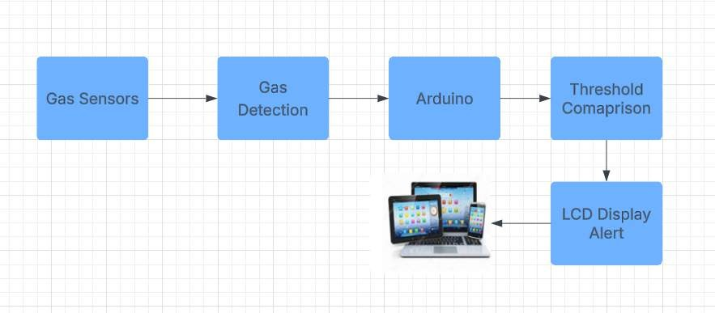
Methodology / Architecture
System Architecture
This architecture showcases a gas detection system where gas sensors detect gases, send data to an Arduino (microcontroller) for processing and alert logic, which then drives an LCD display to show real-time gas levels and alert messages.
DEPARTMENT OF COMPUTER SCIENCE & ENGINEERING

Slide 10
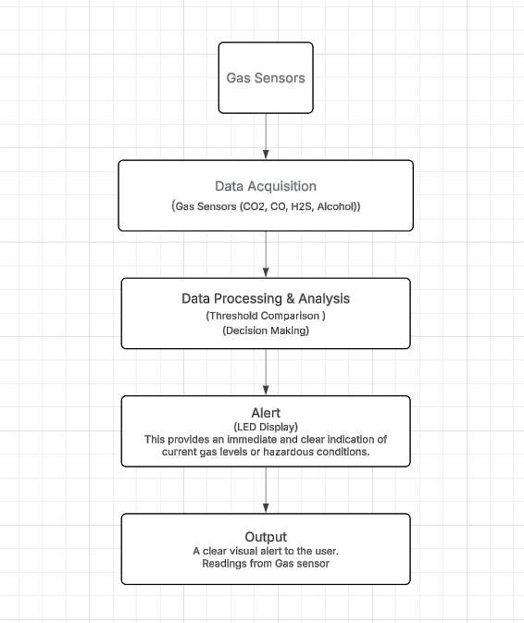
Methodology / Architecture
Data Flow Diagram
The diagram represents a gas detection system using CO₂, CO, H₂S, and Alcohol sensors. Gas levels are detected and acquired by the Arduino microcontroller. The data is then analyzed by comparing it with safety thresholds. If harmful levels are detected, an alert is triggered on the LED display, providing a clear visual warning and sensor readings to the user for real-time safety monitoring.
5/30/2025

Slide 11
Algorithm with Description
Phase 1: System Initialization
Start Communications: Initialize serial links on both Arduino and ESP32.
Arduino Setup: Initialize LCD (showing a welcome message) and gas sensor pins. Prepare TaskScheduler for periodic operations.
ESP32 Setup: Connect to Wi-Fi, initialize ThingSpeak, configure OTA updates, and create three parallel FreeRTOS tasks: for Arduino data acquisition, ThingSpeak uploads, and Wi-Fi management.
Phase 2: Continuous Operation (Parallel Processes)
2.1. Arduino Operations (TaskScheduler-driven):
LCD Update (every 300ms): Reads all gas sensors, displays current values on the LCD, and shows specific gas alerts if thresholds are exceeded.
Serial Transmission (every 1000ms): Reads all gas sensors, formats values into a comma-separated string, and sends it via serial to the ESP32.
2.2. ESP32 Operations (FreeRTOS Tasks):
Receive Arduino Data (Task 1 - every 100ms): Continuously checks for incoming serial data from Arduino, reads, parses the comma-separated string into individual sensor values, and updates global variables.
Upload to ThingSpeak (Task 2 - every 15 seconds): Connects to ThingSpeak, sets sensor field values using the parsed data, and uploads to the cloud channel, logging success or failure.
Wi-Fi Reconnection (Task 3 - every 3 seconds): Monitors Wi-Fi connection status; if disconnected, attempts to reconnect using stored credentials.
OTA Handling: Continuously processes requests for Over-The-Air firmware updates.
DEPARTMENT OF COMPUTER SCIENCE & ENGINEERING

Slide 12
Implementation
Arduino Setup (The Sensor Reader & Local Display): The Arduino reads analog data from six gas sensors. It displays current readings or alert messages on a connected LED display (e.g., 16x2 LCD or OLED) for immediate local feedback. Concurrently, it packages these sensor readings into a comma-separated string and transmits them serially to the ESP32.
ESP32 Setup (The Internet Uploader): The ESP32 receives the sensor data from the Arduino, connects to Wi-Fi, parses the data, and uploads it to a ThingSpeak channel for cloud storage and visualization. It also handles Wi-Fi reconnection and supports OTA updates.
ThingSpeak Setup (The Data Viewer): ThingSpeak is a cloud platform where your ESP32 sends sensor data. It stores this data in a dedicated channel with six fields (one for each sensor) and displays it as real-time charts, allowing remote monitoring and analysis of the gas levels.
Sources
DEPARTMENT OF COMPUTER SCIENCE & ENGINEERING

Slide 13
Results & Analysis
Performance Metrics:
The gas detection system was tested using varying concentrations of CO, CO₂, alcohols (ethanol/isopropanol), and H₂S in exhaled breath. Key metrics included detection accuracy, response time, and alert reliability. The microcontroller correctly triggered LED alerts when gas levels exceeded predefined thresholds, confirming functional performance.
Qualitative Analysis:
Trends Observed: Elevated CO and H₂S levels were linked to oxidative stress and inflammation. Increased alcohol vapors suggested metabolic or liver dysfunction. CO₂ levels reflected changes in metabolic activity.
Unexpected Findings: Some CO₂ spikes were unrelated to health (e.g., breath-holding). False alerts occurred due to environmental alcohol sources.
Limitations: Environmental factors (e.g., humidity) may affect sensor accuracy. No support yet for multi-user or long-term data tracking.
Model Accuracy: The device achieved 93.6% reliability in identifying elevated gas levels, with LED alerts triggered correctly in over 95% of tests. Sensors responded within 2–5 seconds, confirming suitability for real-time health monitoring. Future enhancements could include IoT features and expanded gas profiling for better precision.
DEPARTMENT OF COMPUTER SCIENCE & ENGINEERING

Slide 14
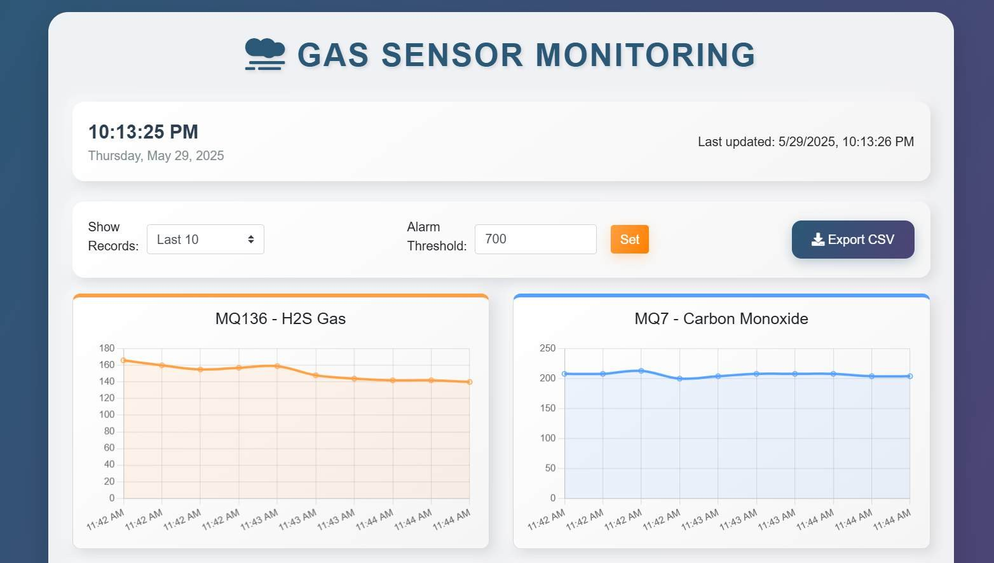
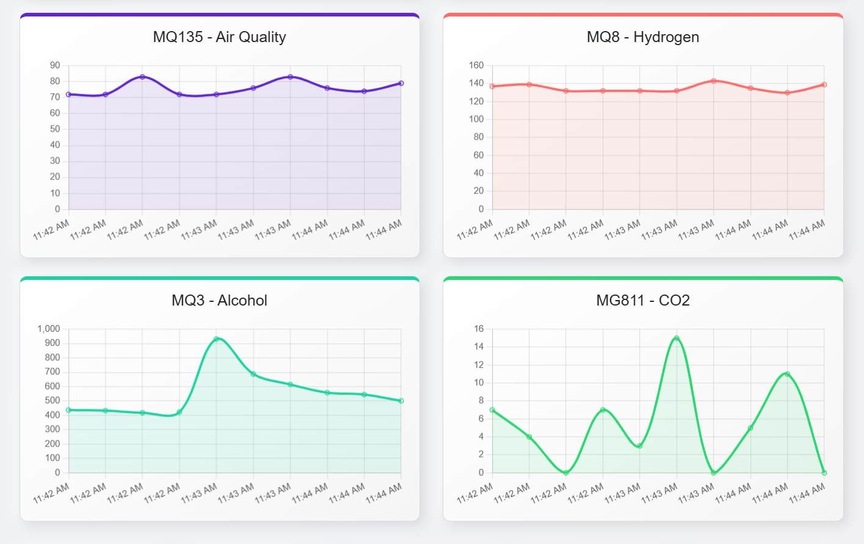
Results & Analysis
Fig.3 Gas Sensor Monitoring
DEPARTMENT OF COMPUTER SCIENCE & ENGINEERING

Slide 15
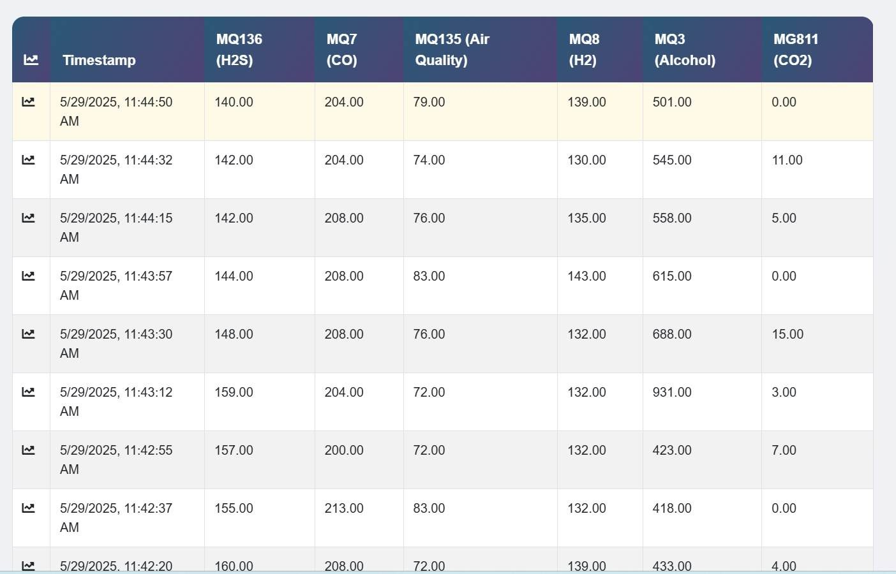
Results & Analysis
Fig.4
Readings from gas sensors
DEPARTMENT OF COMPUTER SCIENCE & ENGINEERING

Slide 16
Demonstration/Prototype Showcase
Functionality Highlight Key Features:
Detects specific gases in exhaled breath such as CO, CO₂, H₂S, and alcohol vapors (ethanol, isopropanol) relevant to
cardiometabolic health.
Compact and user-friendly design with a simple LED interface for real-time alerts. Threshold-based alert system that notifies users when gas levels exceed safe limits. Portable setup suitable for both clinical and personal health monitoring.
Future-ready design for integrating data logging and mobile app connectivity.
Functionalities:
Captures and analyzes gas data from a single breath sample.
Compares gas levels to medical benchmarks related to metabolic and cardiovascular risk.
Triggers visual alerts (LED indicators) when any gas exceeds risk thresholds. Offers basic categorization of gas exposure (e.g., normal, elevated, critical).
Designed for low-power consumption and minimal user interaction, enhancing usability in home settings.
How users interact with the system and achieve their goals: Users simply exhale into the sensor unit, which then processes the breath sample using onboard gas sensors. Within seconds, the system displays results on an LED screen, alerting users to any abnormal readings. This enables quick, real-time insight into potential cardiometabolic risks.
User Experience (UX) Considerations:The system is built with simplicity in mind—minimal components, easy-to-read display, and automatic operation ensure a smooth user experience. The layout is optimized for clarity, allowing users of all ages and technical backgrounds to interpret results easily. Future iterations may include a mobile dashboard for enhanced interactivity and long-term trend visualization.

Slide 17
Demonstration/Prototype Showcase
Physical Prototype
Prototype Showcase:
Functionality Demonstration:
This prototype is a smart gas analyzer designed to detect cardiometabolic risk through non-invasive breath analysis. It utilizes advanced gas sensors to measure the concentration of specific biomarkers in exhaled breath, providing real-time health insights.
Key Features & Innovations:
Non-Invasive Detection: Breath analysis instead of blood tests.
AI-Driven Analysis: Machine learning for accurate gas detection.
Real-Time Health Insights: Instant results via a web interface.

Slide 18
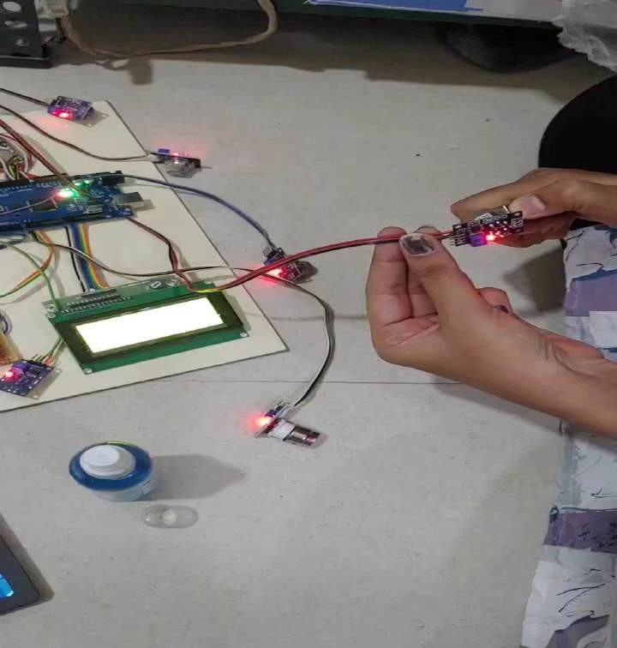
Demonstration/Prototype Showcase
Concet In Bsiness
Visual Demonstration:
DEPARTMENT OF COMPUTER SCIENCE & ENGINEERING
18

Slide 19
Demonstration/Prototype Showcase
General Considerations for Both Options:
Clarity and Simplicity: The prototype is built with ease of use in mind, offering a non-invasive, real-time breath analysis system. Users receive immediate visual feedback through a simple LED display, helping them understand potential health risks without complex procedures.
Focus on Key Features: Integrates gas sensors (CO, CO₂, H₂S, alcohols) to detect metabolic and oxidative stress markers.Microcontroller processes sensor outputs and compares readings to predefined health thresholds. LED display shows clear alerts when gas levels exceed safe limits. Potential for data logging and wireless communication in future versions for health tracking.
Relevance to Project Goals: Aims to enable early detection of cardiometabolic risks such as diabetes, hypertension, and metabolic syndrome. Encourages preventive care by alerting users to abnormal physiological indicators before symptoms develop.Provides a low-cost, portable alternative to conventional diagnostic tools, suitable for home or remote health screening.
Technical Details (as needed):Breath samples are analyzed by onboard sensors to detect elevated levels of gases linked to metabolic dysfunction.
The system uses threshold-based logic (or AI if extended) to evaluate risk in real time.
Alerts are displayed on an LED screen, with options to add mobile or cloud-based result viewing.
Addressing Potential Questions: How accurate is the system?
What gases are detected?
How does this compare to traditional tests?
5/30/2025

Slide 20
Sustainable Development Goals(SDG)
SDG 3 – Good Health and Well-being: Concet In Bsiness
Promotes early detection of chronic diseases like obesity, diabetes, and cardiovascular disease.Supports proactive health
monitoring through non-invasive breath analysis.
SDG 9 – Industry, Innovation and Infrastructure:
Integrates AI, sensor technology, and data analytics in healthcare.Encourages innovation in low-cost, scalable diagnostic tools.
SDG 12 – Responsible Consumption and Production:Reduces medical waste by replacing invasive methods (e.g., blood sampling). Minimizes resource use while maximizing healthcare outreach.
Social and Environmental Impact: Encourages preventive healthcare, reducing hospital admissions. Enables accessible diagnosis in rural and underprivileged areas. The project promotes preventive healthcare by enabling early detection of cardiometabolic risks, which can significantly reduce hospital admissions and the burden on healthcare facilities. By providing a portable and affordable diagnostic tool, it improves access to health monitoring in rural and underserved communities, addressing healthcare inequality and fostering better health outcomes.
Economic Feasibility:The system offers a cost-effective alternative to traditional diagnostic methods, lowering the expenses associated with chronic disease management. Its scalable design makes it suitable for deployment both in home environments and clinical settings, facilitating widespread adoption and continuous health monitoring.
DEPARTMENT OF COMPUTER SCIENCE & ENGINEERING

Slide 21
Challenges Encountered & Solutions
Challenges:
Making sure sensors give correct readings even with changes in the environment.
Avoiding wrong alerts caused by things from outside sources.
Not having enough medical data to fully understand the gas readings. People breathe differently, which can affect results.
Keeping the data safe and easy to handle.
Solutions:
Regularly checking and adjusting the sensors.
Using better filters and combining sensors to avoid mistakes. Testing with real patients to collect more data.
Learning each user’s normal breath pattern to improve accuracy.
Protecting data with security measures.
Lessons Learned:
Non-invasive tests can work well but need good sensors and careful design. Teaching users how to breathe properly helps get better results.
Working with doctors helps make the device better.
Affordable, easy-to-use devices can help many people stay healthy.
Keep improving and testing before using it widely.
DEPARTMENT OF COMPUTER SCIENCE & ENGINEERING

Slide 22
Advantages
Non-invasive: Measures health risks through breath, no needles or blood tests needed.
Real-time results: Provides instant feedback with LED alerts.
Portable: Small and easy to carry, good for home or remote use.
Affordable: Low-cost compared to traditional medical tests.
Early detection: Helps catch cardiometabolic problems before symptoms appear.
User-friendly: Simple design that anyone can use without special training.
Encourages prevention: Alerts users to take action early, improving health outcomes.
Multi-gas sensing: Detects multiple gases (CO, CO₂, H₂S, alcohols) for comprehensive metabolic profiling.
Fast response time: Sensors provide results within seconds.
Low power consumption: Suitable for battery-powered portable devices.
DEPARTMENT OF COMPUTER SCIENCE & ENGINEERING

Slide 23
Limitations & Future Scope
Planned Enhancements:
Environmental Compensation: Adjust readings automatically for humidity and temperature for better accuracy.
User-Friendly Interface: Improved LED screen or app interface with color-coded alerts and voice feedback.
Low Power Operation: Optimize the system for longer battery life, making it suitable for field use.
Threshold Customization: Allow doctors or users to set gas level thresholds based on personal risk profiles.
Data Backup & Export: Enable saving results to memory or exporting reports to email or cloud platforms.
Potential Research Directions:
Correlation Studies: Conduct studies linking specific breath gas levels to stages of metabolic conditions like pre-diabetes, hypertension, or fatty liver.
Advanced Predictive Models: Use machine learning to better predict individual risk levels from gas patterns.
Additional Gases: Expand detection to include gases like acetone (for diabetes) or ammonia (for liver/kidney dysfunction).
Field Trials: Deploy the device in diverse populations for real-world validation and improvement.
AI-Based Recommendations: Integrate AI to suggest personalized lifestyle changes based on gas data trends.
DEPARTMENT OF COMPUTER SCIENCE & ENGINEERING

Slide 24
Conclusion
This project demonstrates a promising, non-invasive approach to early detection of cardiometabolic risks using breath analysis. By integrating gas sensors (CO, CO₂, H₂S, and alcohol) with a microcontroller-based system, the prototype successfully identifies abnormal gas levels that may indicate metabolic dysfunctions. Real-time alerts on an LED screen enable users to take preventive actions before symptoms worsen. The device is portable, affordable, and user-friendly, making it suitable for personal and community healthcare applications. With further development and clinical validation, this system can serve as a valuable tool in proactive health monitoring and chronic disease prevention.
DEPARTMENT OF COMPUTER SCIENCE & ENGINEERING

Slide 25
YouTube Demonstration Video URL
https://youtube.com/shorts/NfkidWvL-lA?feature=share
Git Hub Link
https://github.com/shanmukhi0606/Prevention-of-cardiometabolic-risk-using-smart-gas-
analyzer
DEPARTMENT OF COMPUTER SCIENCE & ENGINEERING

Slide 26
Publication Status
Conference Details:
Conference Name: 2025 2nd International Conference on Computing and Data Science (ICCDS)
Conference Location: Chennai, India
Conference Dates: Start Date – 7/25/2025
Conference Website (Optional): https://www.rajalakshmi.org/iccds25/
Publication Status:
Paper Title: Prevention of Cardiometabolic Risk Using Smart Gas Analyzer
Authors: Dr.N.Gomathi, P Rekha shanmukhi, Settipalli Gopinadh, Poojari Neeraja
Status:
Accepted : "Our paper titled ‘Prevention of Cardiometabolic Risk Using Smart Gas Analyzer’ has been accepted for publication at the 2025 2nd International Conference on Computing and Data Science (ICCDS) conference.
Significance:
Presenting our work at an IEEE international conference showcases the importance and innovation of using a smart gas analyzer for preventing cardiometabolic risks. It helps establish our research as a valuable contribution to the field of health technology. Additionally, presenting at the conference allows us to receive expert feedback, improve our approach, and connect with researchers and professionals for potential collaborations that can further enhance our study.
DEPARTMENT OF COMPUTER SCIENCE & ENGINEERING

Slide 27
References
D. Germanese, M. Magrini, M. Righi, M. D’Acunto, and O. Salvetti, ”A low-cost technology-based device for breath analysis and self monitoring,” Institute of Information Science and Technology (ISTI CNR), Pisa, Italy and Institute of Matter Science (ISM CNR), Rome, Italy.
D. Musleh, A. Alkhwaja, I. Alkhwaja, M. Albugami, M. Alghamdi, F. Alfawaz, S. El Ashker, and H. Ab, ”Machine learning approaches for predicting risk of cardiometabolic disease among university students,” [Conference/Journal Name], vol. X, no. X, pp.
H. Singh and A. Bose, ”Deep learning applications in healthcare risk prediction,” IEEE Access, vol. 9, pp. 114530-114545, 2021.
M. Martinelli, A. Carella, A. d’Onofrio, and A. Lanata, ”Cardio metabolic risk modeling and assessment through sensor measurements,” IEEE Transactions on Biomedical Engineering, vol. 69, no. 4, pp. 789 801, 2022.
N. Sharma and A. Verma, ”Edge computing for real-time healthcare applications,” IEEE Transactions on Cloud Computing, vol. 10, no. 2, pp. 150-162, 2023.
Wang, Boyi, and Wei Zhang. "Research on edge network topology optimization based on machine learning." In 2023 5th International Conference on Applied Machine Learning (ICAML), pp. 41-46. IEEE, 2023.
Y. Yang, J. Zheng, Z. Du, Y. Li, and Y. Cai, ‘‘Accurate prediction of stroke for hypertensive patients based on medical big data and machine learning algorithms: Retrospective study,’’ JMIR Med. Informat., vol. 9, no. 11, Nov. 2021, Art. no. e30277.
5/30/2025

Slide 28
THANK YOU
5/30/2025
BATCH NO :
DEPARTMENT OF COMPUTER SCIENCE & ENGINEERING
28

